Slide 1
Simplifying and Isolating Failure-Inducing Input
Authors: Andreas Zeller & Ralf Hildebrandt

Slide 2
Introduction
Bugs in large-scale software require simplification for debugging.
Delta Debugging identifies the minimal failure-inducing input.
Example: Mozilla’s BugAThon—370+ open bug reports needed manual simplification.

Slide 3
The Problem Statement
Challenge: Identifying which parts of an input cause failure in large test cases.
Conflicting Goals:
Bug reports must be specific enough for debugging.
Test cases should be minimal for generalization.
Solution: Automate test case simplification with Delta Debugging

Slide 4
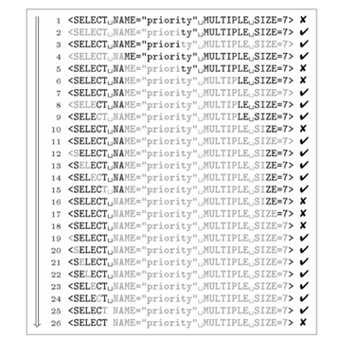
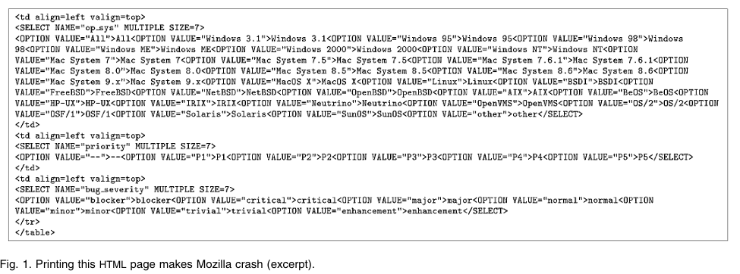
Delta Debugging Approach
Automated process to remove irrelevant input parts iteratively.
Example: Mozilla crash was simplified from 95 user actions to 3 actions.

Slide 5
Delta Debugging Algorithm (ddmin)
Input: Failing test case
Process:
Split input into parts.
Test if each subset still fails.
Reduce to the smallest failing subset.
Output: Minimal failure-inducing input

Slide 6
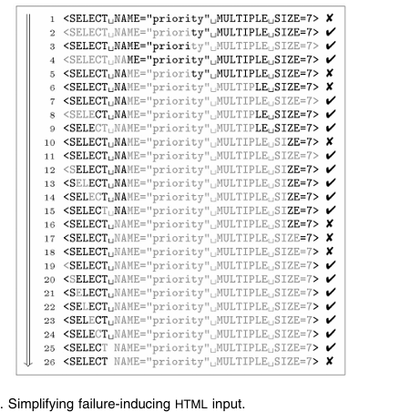
Case Study 1 – Mozilla Print Bug
Bug Report: Printing a webpage crashes Mozilla.
Delta Debugging Steps:
Recorded 95 user actions → reduced to 3 relevant actions.
HTML input reduced from 896 lines to a single line (<SELECT> tag).

Slide 7

Delta Debugging Algorithm (ddmin)
Initial State:
The original webpage had 896 lines of HTML.
A crash occurs, but we don’t know why.
Step 1: Divide Input in Half
We split the 896 lines into:
First half (448 lines): Fails
Second half (448 lines): Does not fail
We keep the failing half.
Step 2: Further Reduction
Keep splitting and testing, reducing down to just one line of HTML.
The crash-inducing element is identified as the <SELECT> tag.
Final Output:
The minimal failure-inducing HTML file consists of just one line that triggers the bug.

Slide 8
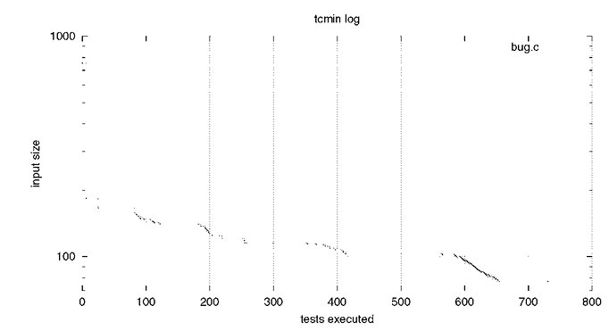
Case Study 2 – GCC Compiler Crash
Case Study 2 – GCC Compiler Crash
Bug: A C program crashed GCC (2.95.2) when optimized.
Delta Debugging reduced input:
755-character input → 77 characters.
Identified a single assignment in a function as the issue.
Further Debugging: GCC compiler flags tested to isolate faulty optimizations.

Slide 9
Case Study 2 – GCC Compiler Crash
Initial State:
A C program (755 characters) crashes GCC with optimization enabled.
We need to find the minimal failure-inducing code.
Step 1: Divide Code in Half
We split the 755-character program into:
First half (378 characters): Fails
Second half (377 characters): Does not fail
We keep the failing half.
Step 2: Continue Reduction
Split again, reducing from 378 characters to 188, then to 77 characters.
Step 3: Identifying the Root Cause
The failure was traced to a single assignment inside a function.
Further debugging found that removing a specific GCC optimization flag (-O2) prevented the crash.

Slide 10
Case Study 3 – UNIX Fuzz Testing
Fuzz Testing: Sending random input to UNIX utilities.
Results: 43% of tested programs crashed on malformed input.
Delta Debugging reduced failure-inducing input from megabytes to a few characters.
Initial State:
A UNIX utility (FLEX) crashed when given a malformed input of several megabytes.
We need to reduce the input to its essential cause.
Step 1: Divide Input in Half
We split the large input into:
First half: Fails
Second half: Does not fail
We keep the failing half.
Step 2: Further Reduction
Continue splitting and testing, reducing from megabytes to just a few characters.
Step 3: Identifying the Root Cause
The crash was triggered by a single malformed character in the input

Slide 11
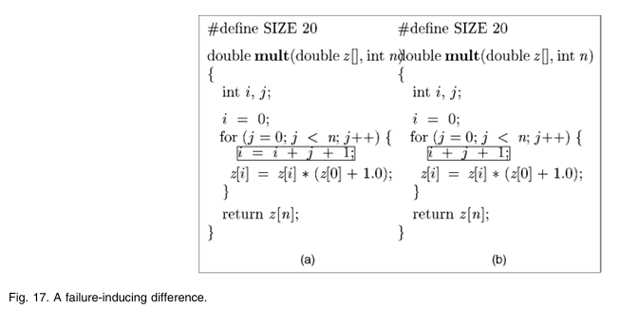
Isolating Failure-Inducing Differences
Test Cases: A subset of input changes affecting program execution.
Delta Debugging (ddmin): Minimizes failing test cases by iteratively removing parts of input.
Delta Debugging (dd): Isolates failure-inducing differences by comparing failing & passing cases.

Slide 12
Comparing ddmin vs. dd
Algorithm | Purpose | Efficiency | Use Case
ddmin | Simplifies a failing test case | Slower | Large test cases
dd | Isolates differences between passing & failing cases | Faster | Finding root cause
Feature | ddmin (Minimization) | dd (Isolation)
Approach | Reduces input to the smallest failing case | Finds the minimal difference between failing & passing cases
Complexity (Best Case) | O(n) | O(log⁡n)
Complexity (Worst Case) | O(n^2) | O(n^2)
Example | Mozilla HTML reduced from 896 lines → 1 | Failure-inducing SELECT tag isolated in 7 steps

Slide 13
Precision in Debugging: Ensuring Correct Failure Detection
- Issue: Reducing input might trigger a different failure than the original.
- Solution: Use backtrace comparison (stack traces) to ensure the same failure occurs.
- Example: Comparing call stack locations to confirm whether it's the same bug or a different one.

Slide 14
When Should You Use dd or ddmin?
Use dd for large inputs → Faster failure isolation
Use ddmin when no passing test case is available
Use backtrace comparison for better debugging
dd is preferred if a minimal difference can be isolated quickly
Example: In Mozilla case, dd required 7 tests while ddmin took 26 tests!

Slide 15
Limitations
High Test Execution Cost: Requires multiple test executions, making it slow for large test cases.
Handling Non-Deterministic Failures: Struggles with bugs that don’t always occur in the same way.
Lack of Contextual Understanding: It only reduces input size but doesn’t explain why the failure occurs.
Size of Input Matters: Works best for structured inputs like HTML but struggles with unstructured data.
Complexity for Large Inputs: More test runs are required for very large files, leading to performance issues.

Slide 16
Summary & Impact
Delta Debugging automates debugging by simplifying test cases.
Saves developers time and effort in bug tracking.
Has applications in compiler debugging, web browsers, and fuzz testing.

Slide 17
THANKS
Presentation by
Shuvanidhi Suresh- 40293590

